Slide 1
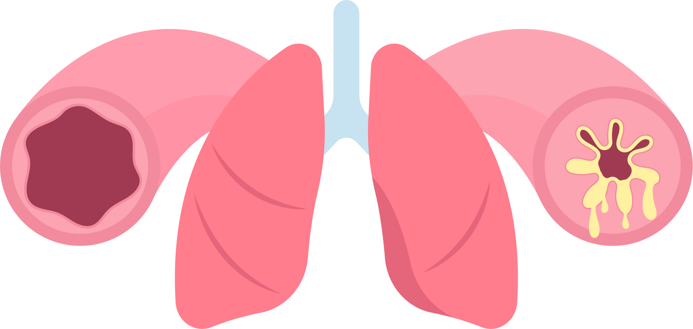
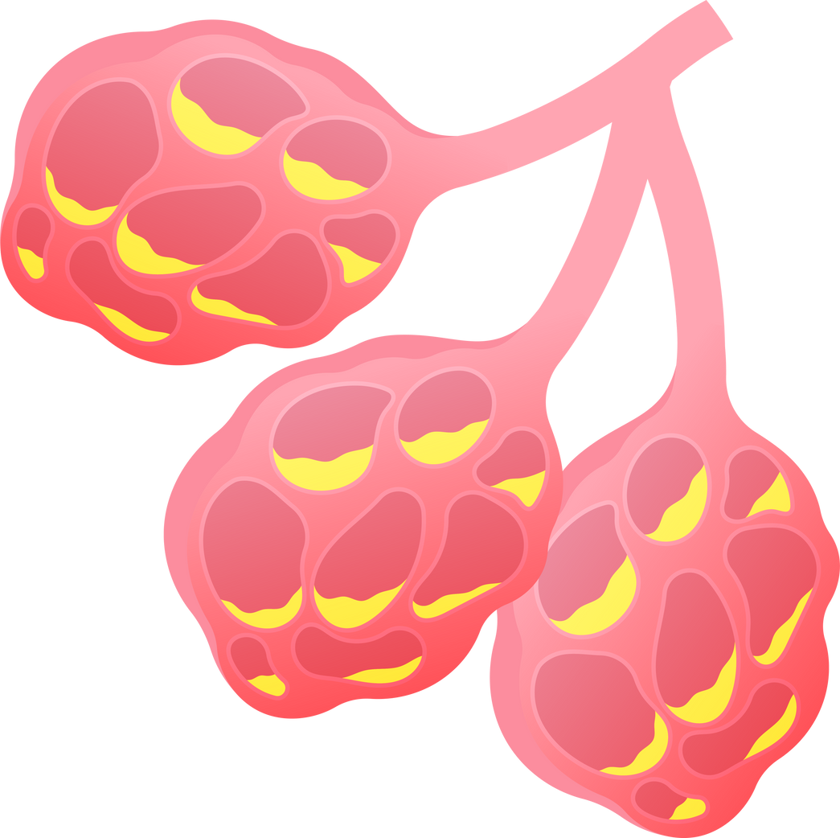


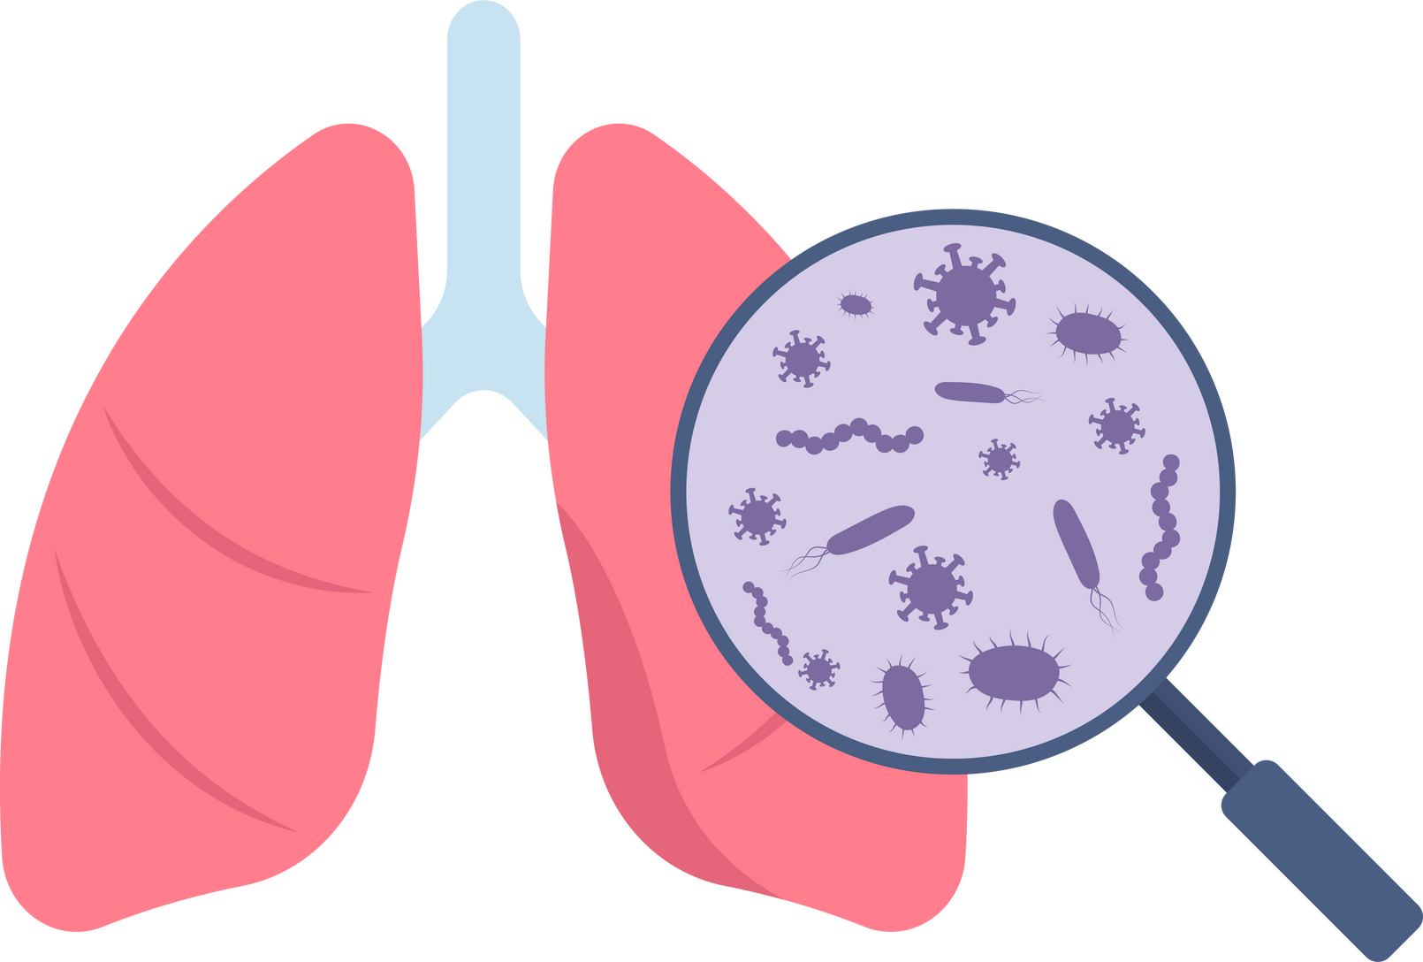
UNIVERSITÀ DELLA CALABRIA
AI & CS - DEEP LEARNING
A.A. 2024/2025
FROM CHEST X-RAYS TO MEDICAL REPORTS:
A DEEP LEARNING APPROACH
An Overview
FRANDINA ILARIA 264232 - SICILIANO SAMUELE 263633 - SPADAFORA PIERPAOLO 263722

Slide 2






SUMMARY
Introduction
Dataset Cleaning
Main Architecture
Custom Transformer
Image Reconstruction
Conclusions

Slide 3
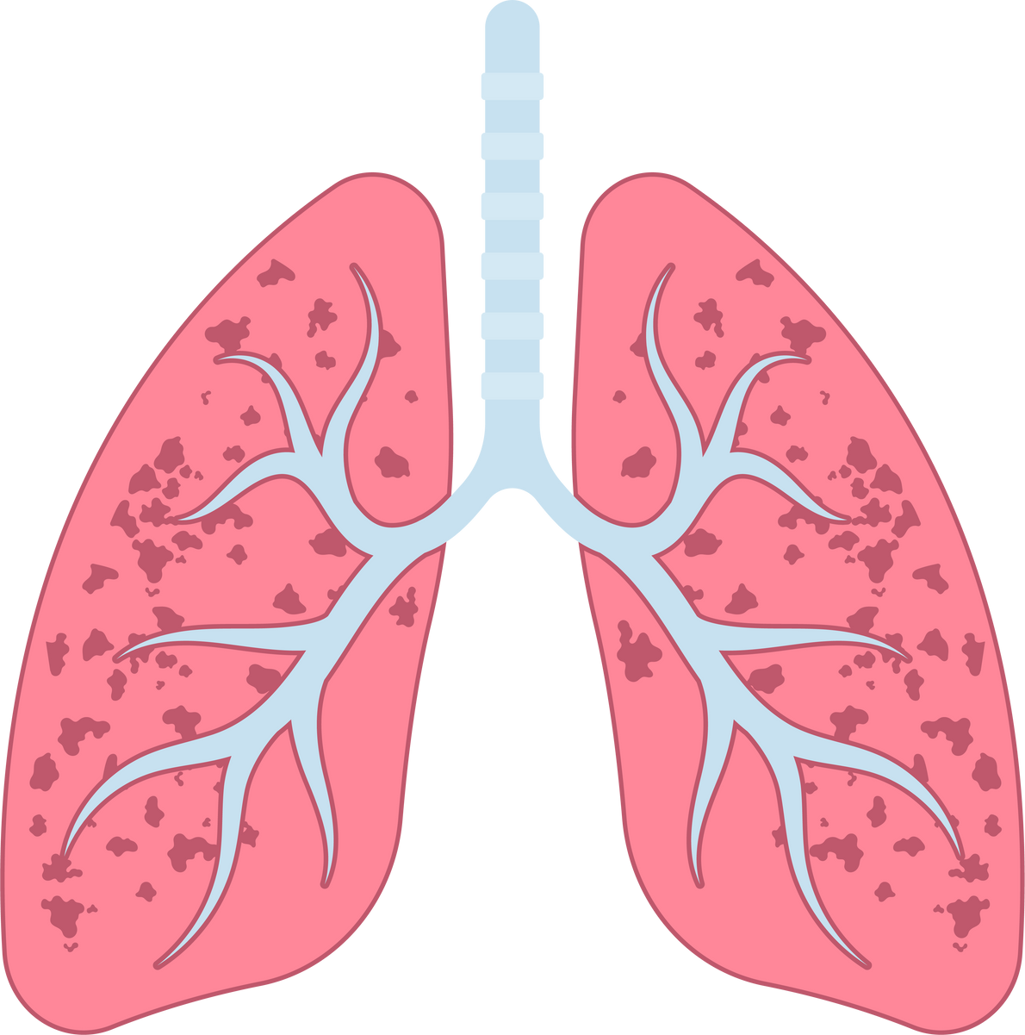
INTRODUCTION
Multi-Modal Chest X-Ray Analysis: Classification, Report Generation, and Image Reconstruction
MOTIVATION & CONTEXT
DATASET OVERVIEW
KEY OBJECTIVES
Automate the analysis of chest X-rays to support radiological diagnostics
Integrate both image classification and natural language report generation
Data Cleaning
Feature extraction using ResNet50
GPT-2/Custom transformer for caption generation
VAE approach for image reconstruction
Utilizes the Indiana University Chest X-ray dataset
Contains paired frontal and lateral views along with textual reports

Slide 4

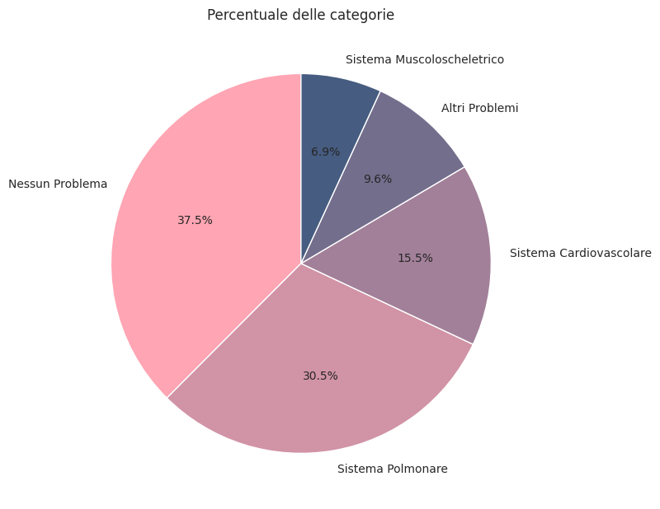
STEPS
DATASET CLEANING
We discarded:
records lacking essential report data such as captions or detailed problem information;
records who don’t have exactly a front image and a lateral image;
categories that appear less than THRESHOLD times.
For each patient with multiple problems, we selected only the first problem listed.
We grouped similar problems in macro-categories.
The symptoms of cystic fibrosis include, persistent coughing, regular lung infections, reduced weight gain, changes to bowel movements, jaundice and the clubbing of finger tips or toes.

Slide 5
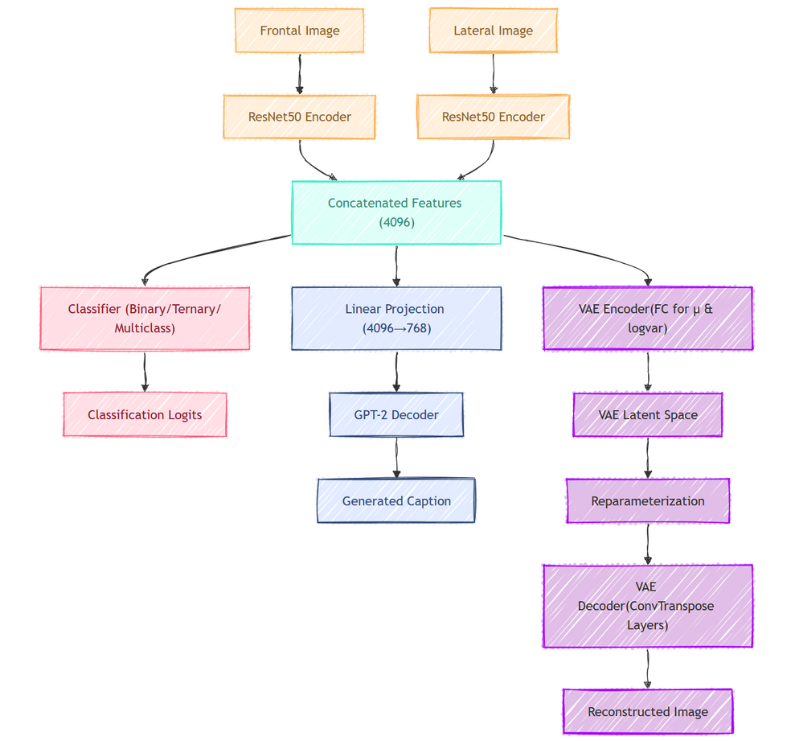
TRIAL ARCHITECTURE
We initially experimented with a unified architecture that leveraged the losses from all three branches simultaneously to enhance model training. However, despite optimizations such as Focal Loss and a Learning Rate Scheduler, adapting the latent space to accommodate the needs of all three models led to a significant decline in text prediction performance and disease classification accuracy.
BINARY CLASSIFICATION
* = ACCURACY
*CLASS 0 | *CLASS 1 | TOTAL ACCURACY | BLEU-4 | ROUGE-L
61.46% | 68.33% | 65.75% | 0.0442 | 0.2427
TERNARY CLASSIFICATION
*CLASS 0 | *CLASS 1 | *CLASS 2 | TOTAL ACCURACY | BLEU-4 | ROUGE-L
15.12% | 68.20% | 39.52% | 41.76% | 0.0436 | 0.2564
MULTICLASS CLASSIFICATION
*CLASS 0 | *CLASS 1 | *CLASS 2 | *CLASS 3 | *CLASS 4 | TOTAL ACCURACY | BLEU-4 | ROUGE-L
38.54% | 8.29% | 14.71% | 41.30% | 34.09% | 24.91% | 0.0435 | 0.2517
True Caption:
The cardiac contours are normal. The lungs are clear. Thoracic spondylosis.
Pred Caption (Model Output):
The heart and lungs have XXXX XXXX in the interval. Both lungs are clear and expanded.
No pleural air collections. Heart and mediastinum normal.

Slide 6
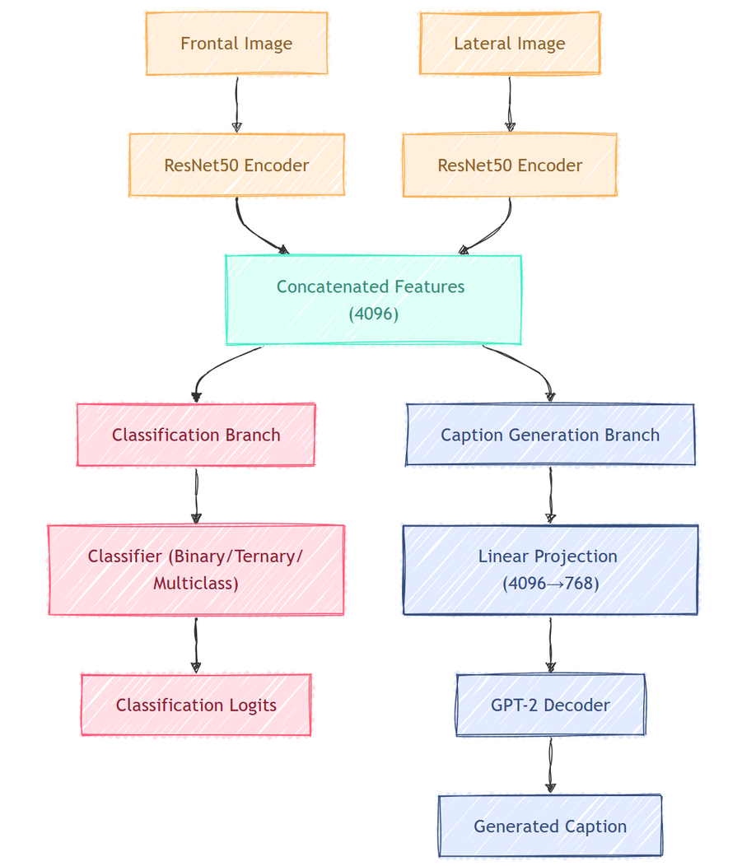
MAIN ARCHITECTURE
Our dual-branch architecture processes frontal and lateral X-ray images through a shared ResNet50 encoder to extract robust 2048-dimensional features that are concatenated into a 4096-dimensional vector, which feeds into an MLP classifier for binary, ternary, or multiclass predictions and a linear projection followed by a GPT-2 decoder for generating coherent medical captions.
BINARY CLASSIFICATION
* = ACCURACY
*CLASS 0 | *CLASS 1 | TOTAL ACCURACY | BLEU-4 | ROUGE-L
74.63% | 67.45% | 70.73% | 0.2067 | 0.2375
TERNARY CLASSIFICATION
*CLASS 0 | *CLASS 1 | *CLASS 2 | TOTAL ACCURACY | BLEU-4 | ROUGE-L
49.27% | 58.53% | 37.90% | 50.37% | 0.2352 | 0.2410
MULTICLASS CLASSIFICATION
*CLASS 0 | *CLASS 1 | *CLASS 2 | *CLASS 3 | *CLASS 4 | TOTAL ACCURACY | BLEU-4 | ROUGE-L
83.90% | 3.19% | 64.38% | 12.20% | 13.53% | 44.87% | 0.1606 | 0.2334
True Caption:
Lungs are clear. There is no pneumothorax or pleural effusion. The heart and mediastinum are within normal limits. Bony structures are intact.
Pred Caption (Model Output):
Heart size upper limits of normal. Mediastinal contour within normal limits but stable. No pneumothorax or large pleural effusions. No focal areas
of consolidation or pneumothorax. area of pulmonary consolidation is identified. No pneumothorax or effusion is identified.

Slide 7
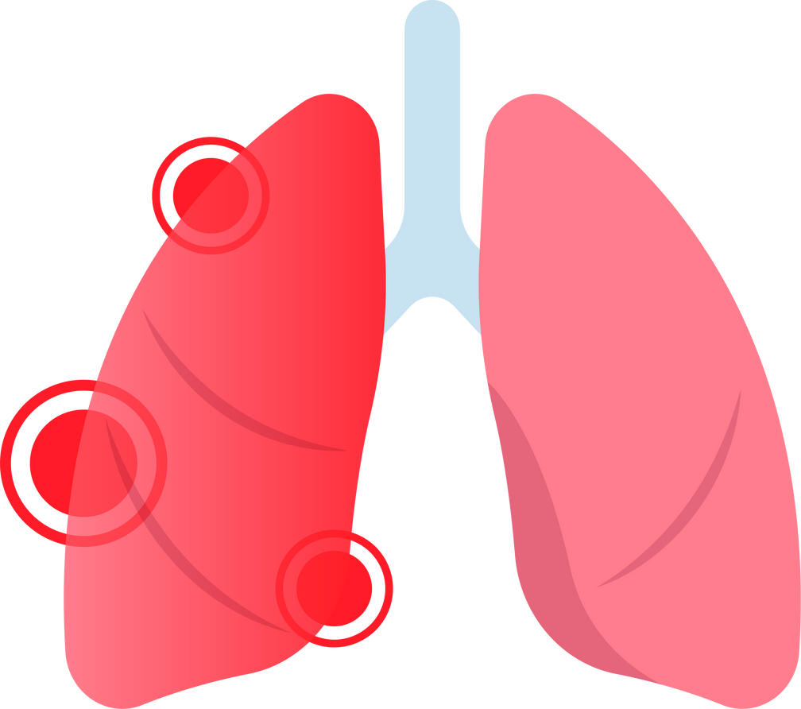
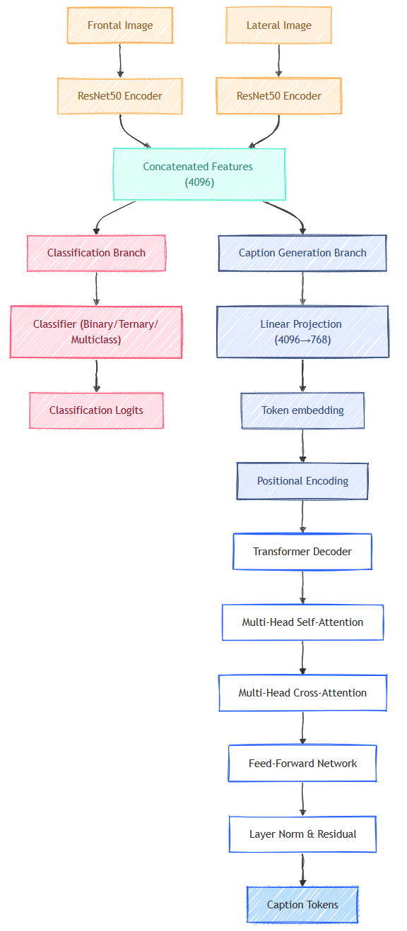
CUSTOM TRANSFORMER
The transformer decoder used in our model for medical caption generation builds on an architecture similar to GPT-2.
Positional encoding integrates sinusoidal functions to inject positional information into the token embeddings, ensuring that the model can capture sequential order.
The self-attention mechanism allows the model to focus on relevant parts of the input sequence while generating each token. A square subsequent mask prevents the model from peeking into future tokens, enforcing an
autoregressive generation process. The forward pass processes the target sequence and image features, passing them to the transformer decoder, which outputs logits for each token in the sequence. The generate_report` method uses autoregressive generation, iteratively predicting tokens, and stopping once the end of sequence (EOS) token is predicted or the maximum sequence length is reached. This architecture enables coherent and contextually relevant captions based on medical images.
BINARY CLASSIFICATION
*CLASS 0 | *CLASS 1 | TOTAL ACCURACY | BLEU-4 | ROUGE-L
61.46% | 68.33% | 65.75% | 0.0442 | 0.2427
MULTICLASS CLASSIFICATION
*CLASS 0 | *CLASS 1 | *CLASS 2 | *CLASS 3 | *CLASS 4 | TOTAL ACCURACY | BLEU-4 | ROUGE-L
38.54% | 8.29% | 14.71% | 41.300% | 34.09% | 24.91% | 0.0435 | 0.2517
True Caption:
The cardiac contours are normal. The lungs are clear. Thoracic spondylosis.
Pred Caption (Model Output):
cardiomediastinal silhouette and hilar contours. Lungs are clear without focal consolidation, pneumothorax, large pleural effusion, or pneumothorax.
Cardiomediastinal contours are unremarkable. Negative for acute bony findings. Stable degenerative changes of the thoracic spine. No XXXX. Stable
mild degenerative changes of the thoracic spine. Degenerative changes noted within the thoracic spine. [...] Stable normal limits.

Slide 8

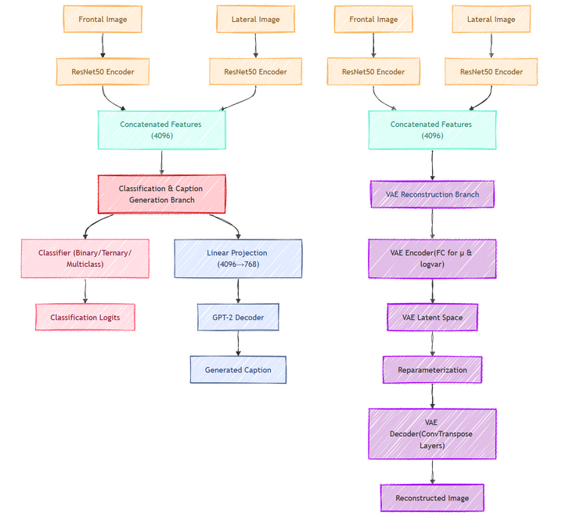
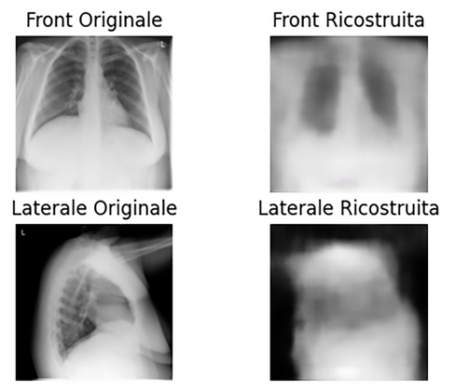
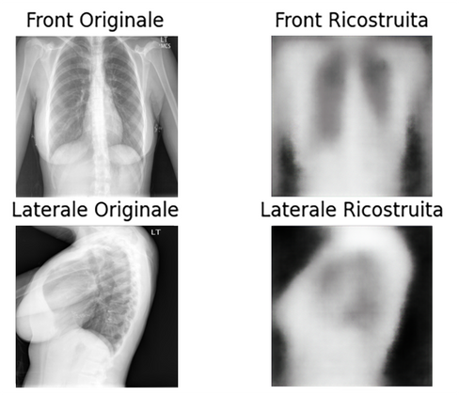
IMAGE RECONSTRUCTION
For the image reconstruction task, the model uses a shared ResNet50 encoder to extract features from both frontal and lateral images, which are then concatenated into a 4096-dimensional vector. This vector is processed by a Variational Autoencoder (VAE) to map the features into a latent space and reconstruct the images, ensuring that both the frontal and lateral views are faithfully reproduced.
TRIAL
ARCHITECTURE
The final design employs a dual-branch architecture where the reconstruction VAE operates independently, ensuring high-fidelity image reconstructions without interfering with the other model functionalities.
Initially, we experimented with a unified approach that combined losses from all three branches simultaneously. However, adapting the latent space to meet the diverse requirements compromised the reconstruction quality.
FINAL
ARCHITECTURE

Slide 9
CONCLUSIONS
This study would undoubtedly benefit from a better dataset: one with more images, higher quality, greater consistency, and above all, more standardized and problem-specific labels/findings, ensuring deeper and less ‘noisy’ knowledge of the surrounding environment.
FUTURE DEVELOPMENTS
Integrating transformers closer to the state of the art—such as DeepSeek., LLaMA, or models like BIOGPT (a GPT-2 variant fine-tuned for the medical domain) would be an excellent strategy for enhancing the prediction of specialized medical terminology.
Using feature extractors with more parameters, running additional epochs, and applying further refinements could significantly improve the construction of the latent space.

Slide 10
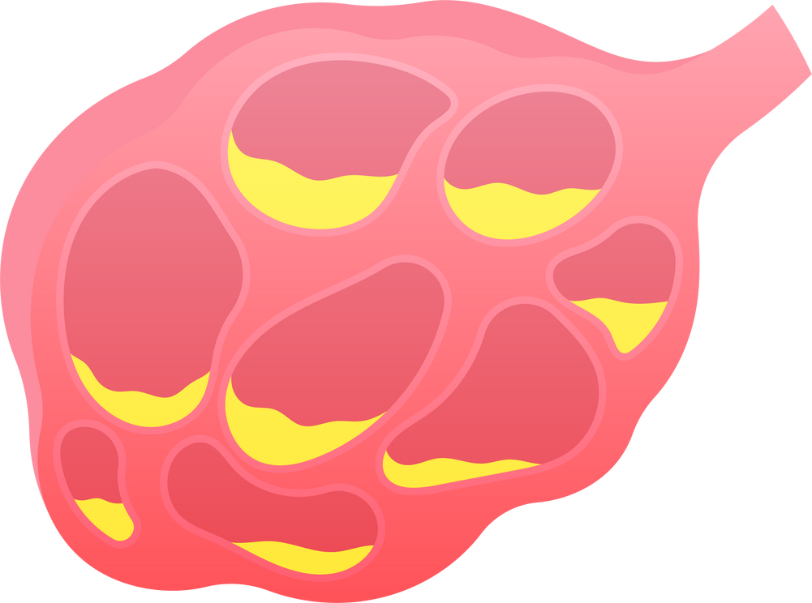

ALLEGRO CHIRURGO
The End

